Slide 1



The effects of pathogenic fungi, herbivores, and predators on pioneer vegetation in tropical forests vary with elevation.
6th European Conference of Tropical Ecology
Ceske
Budejovice 2023
Piotr Szefer
Department of Zoology, USB
Department of Entomology, BC

Slide 2
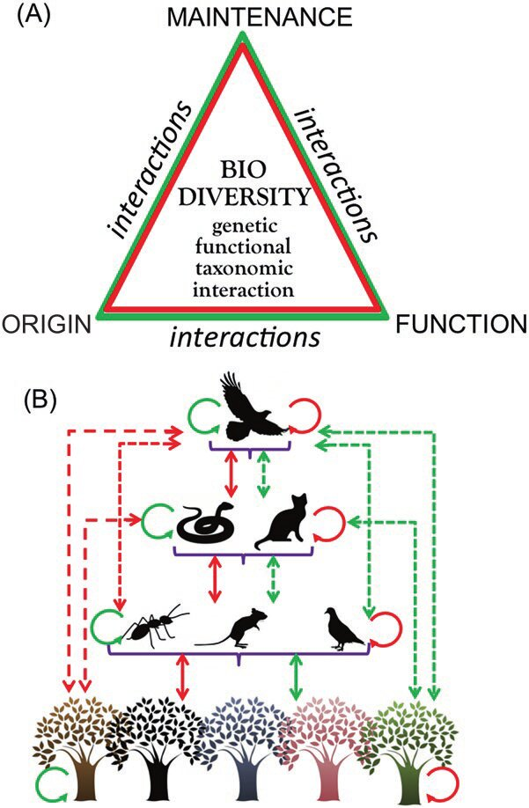
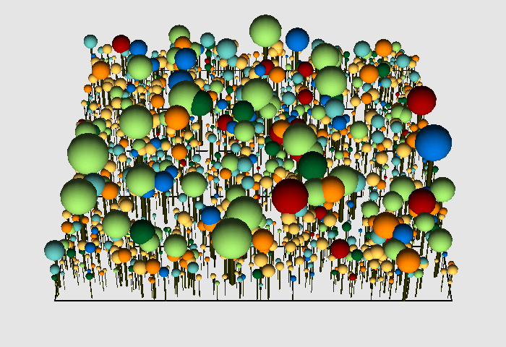
Introduction
Plant-driven models of regeneration.
Biotic interactions are important but their role in regeneration understudied.

Slide 3
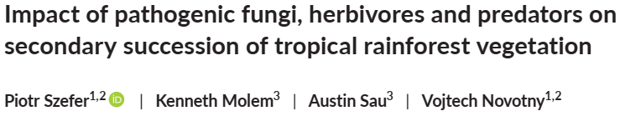
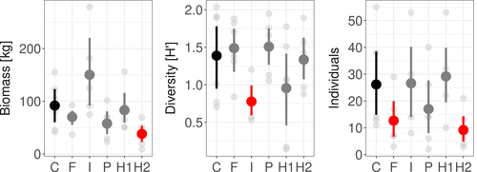
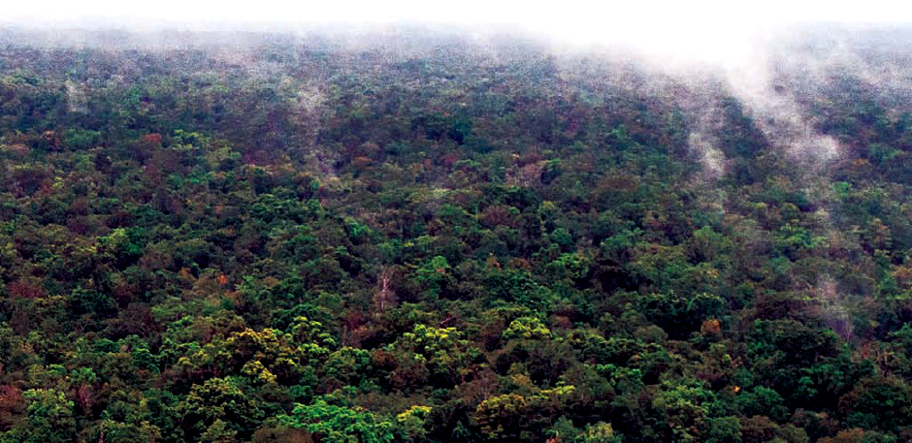
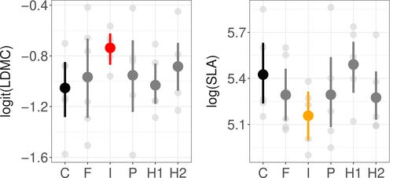
Introduction
Control
Predator ex.
Predator ex.
+
H1
Insecticide
Fungicide
Predator ex.
+
H2

Slide 4
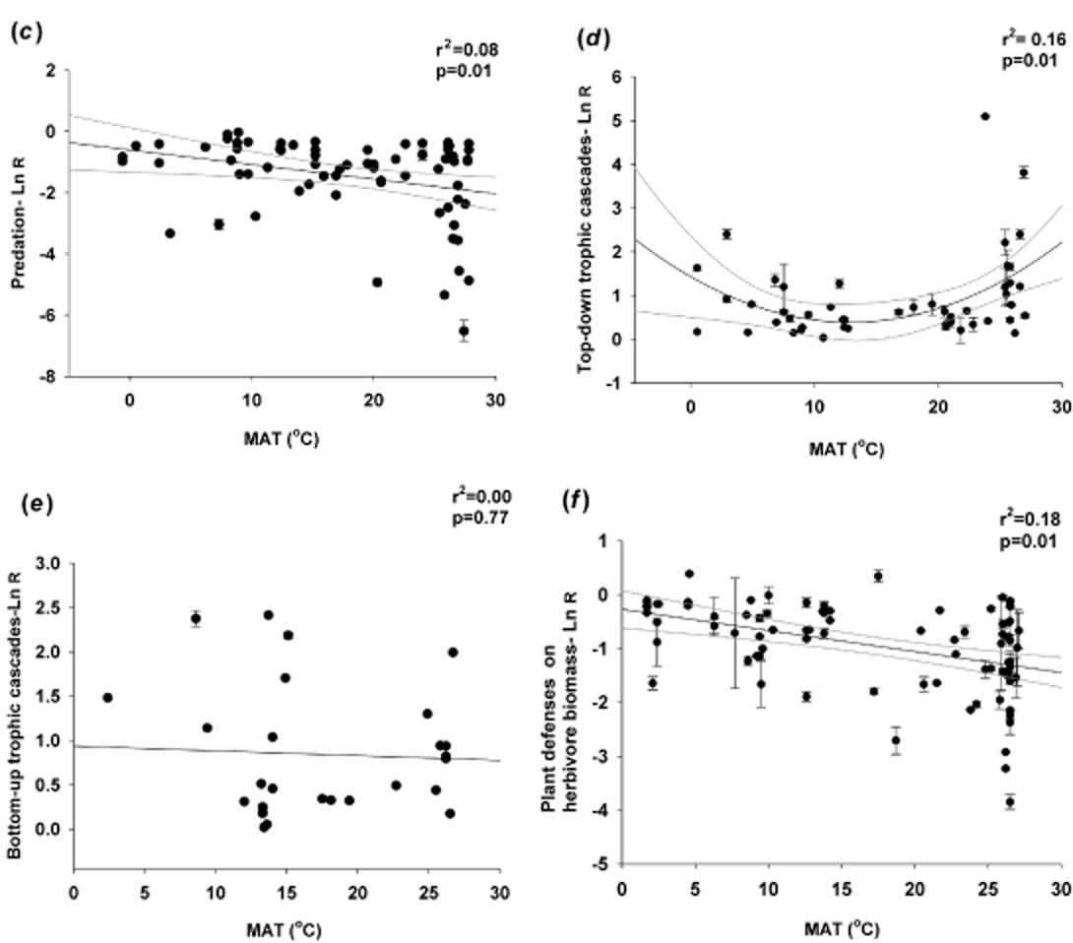
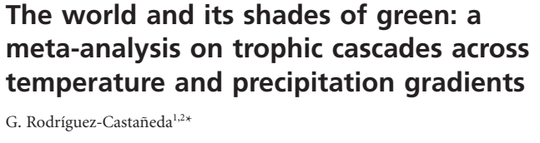
Introduction
Abiotic factors influence the strength of top-down effects.

Slide 5
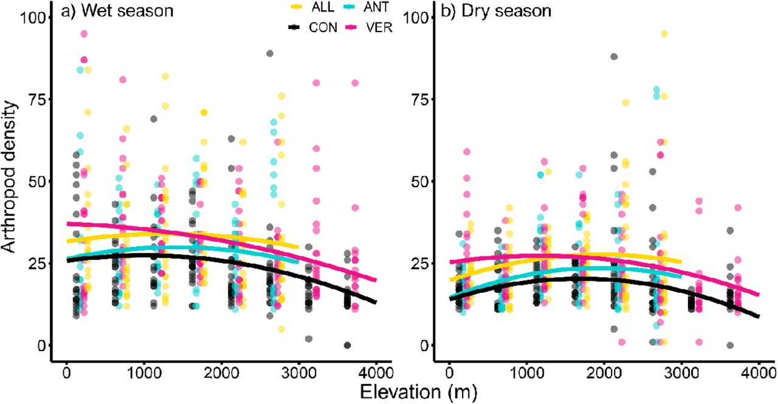
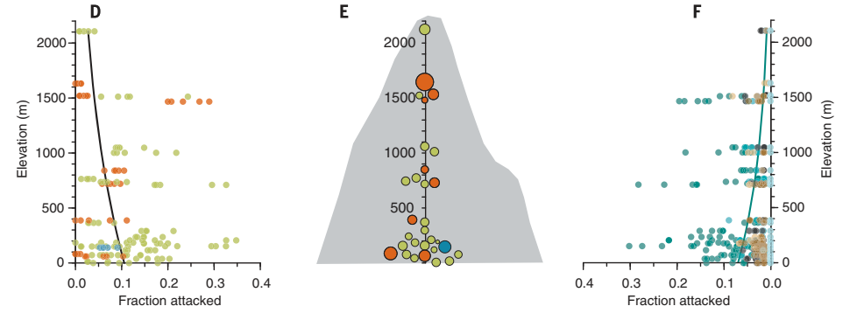
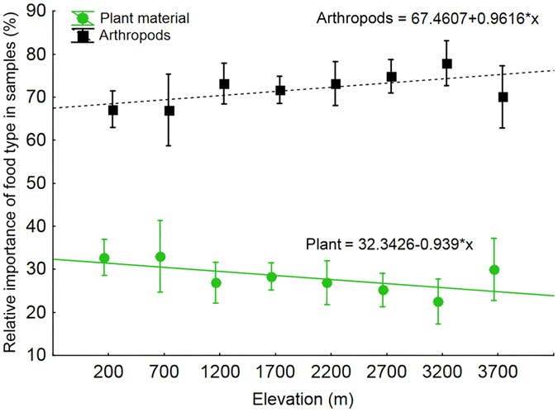
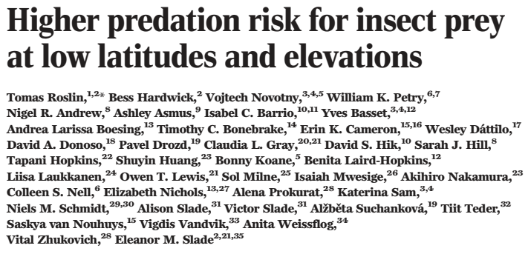
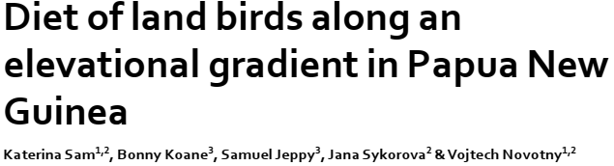
Objective of the study
Weak effects of insects and predators?
Stronger effects of fungi?

Slide 6
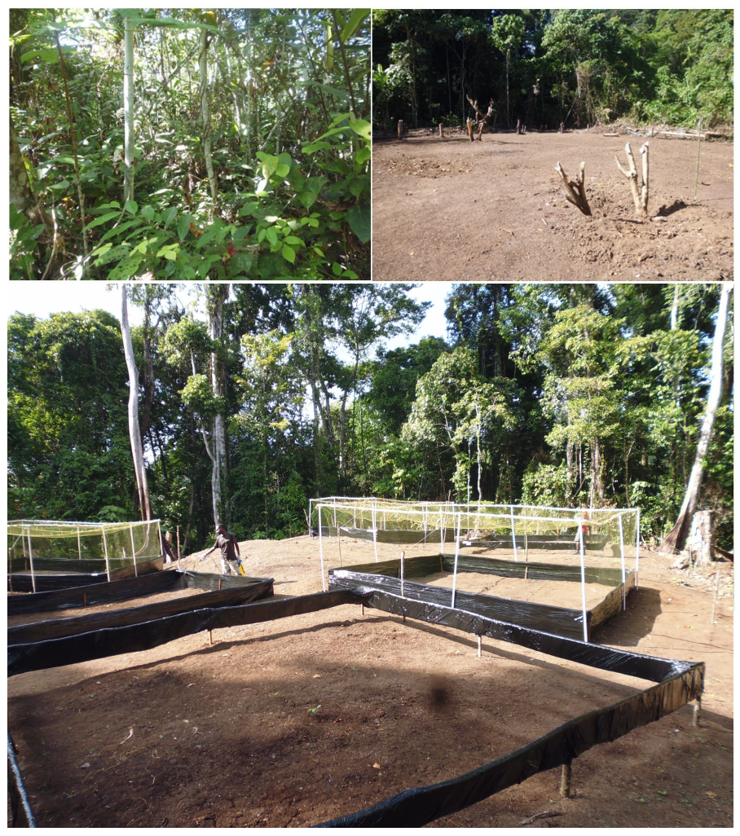
Methodology
Control
Predator ex.
Predator ex.
+
Herbivores
Insecticide
Fungicide
Wanang
200 m
Numba
700 m
Yawan
1900 m

Slide 7
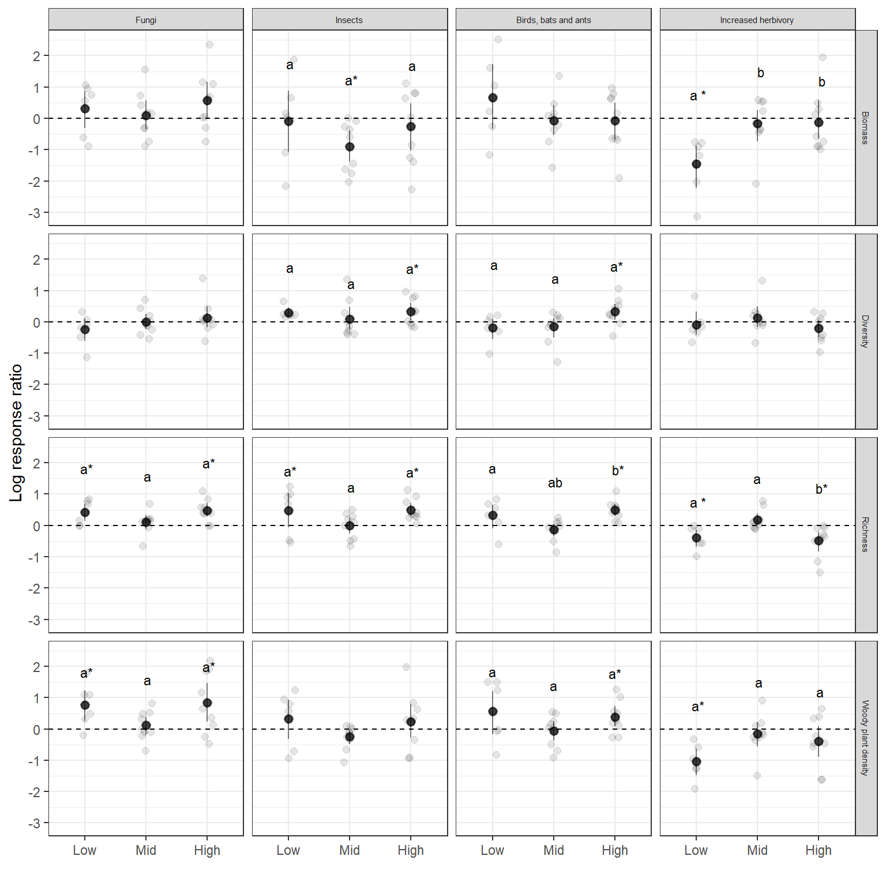
Elevational patterns
Nonlinear relationship with elevation.
Weak effects at the mid-elevation.
Similarities between low and high elevations.

Slide 8
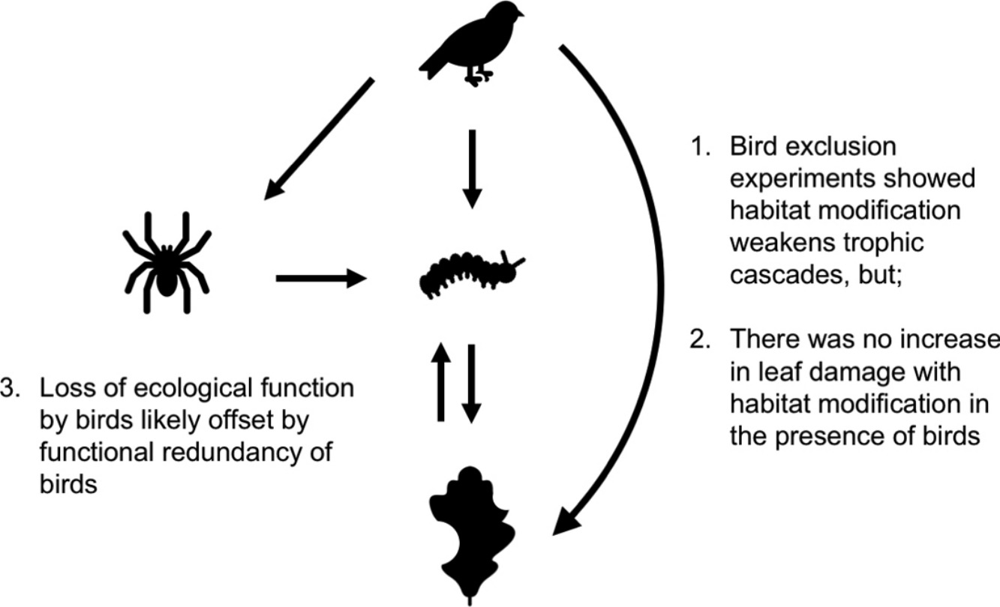
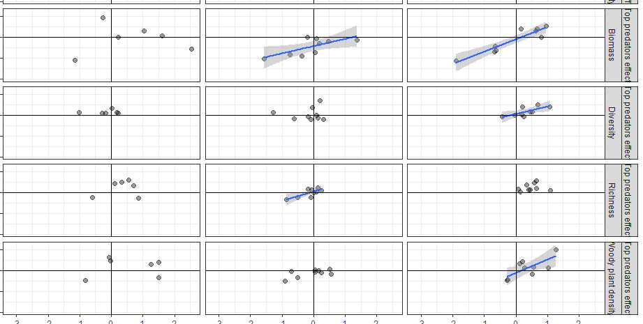
Effects of biotic factors
Wanang
200 m
Numba
700 m
Yawan
1900 m
-
+
+
-

Slide 9
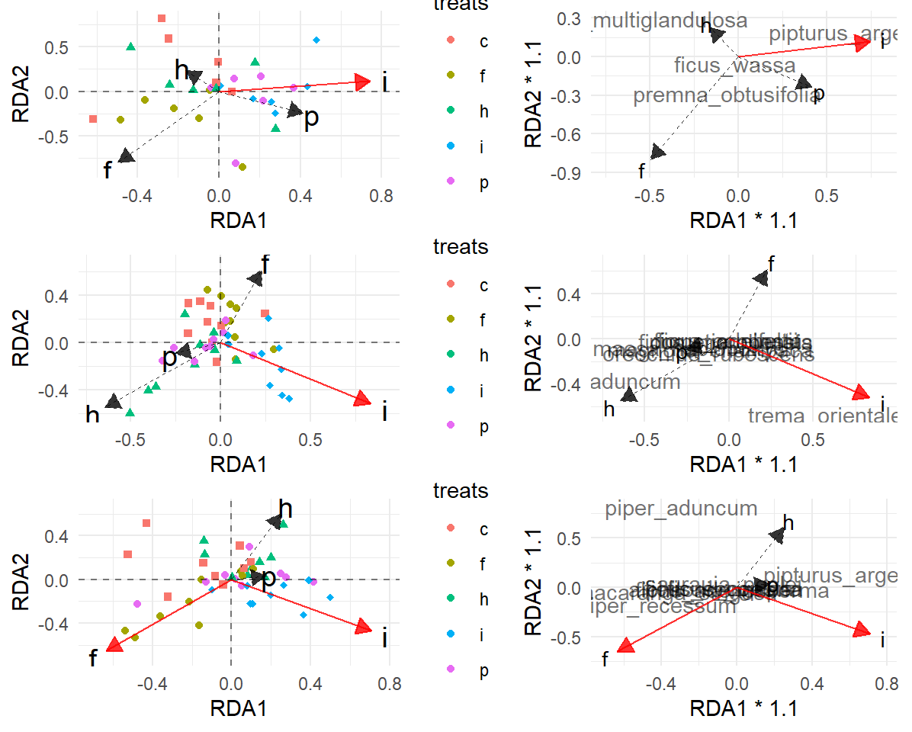
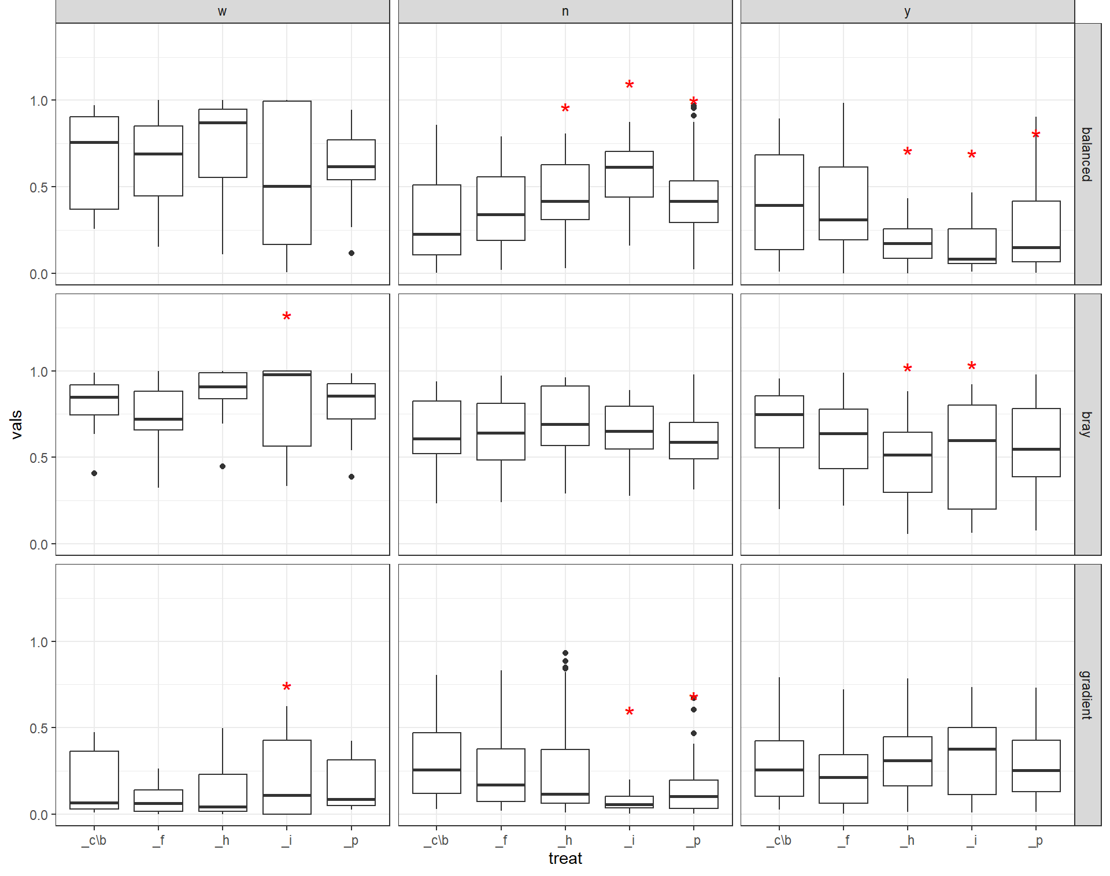
Community composition

Slide 10
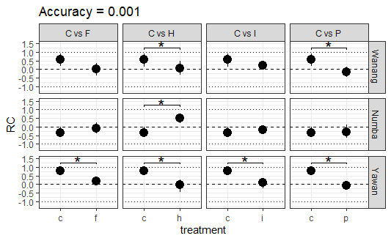
Community composition

Slide 11
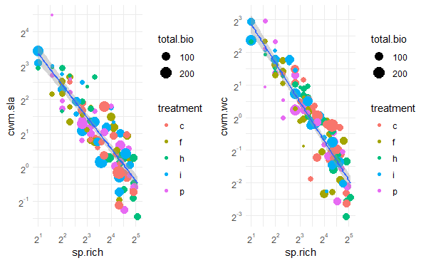
Traits and Responses
Community weighted means for SLA and water content were closely related to plant species richness.

Slide 12
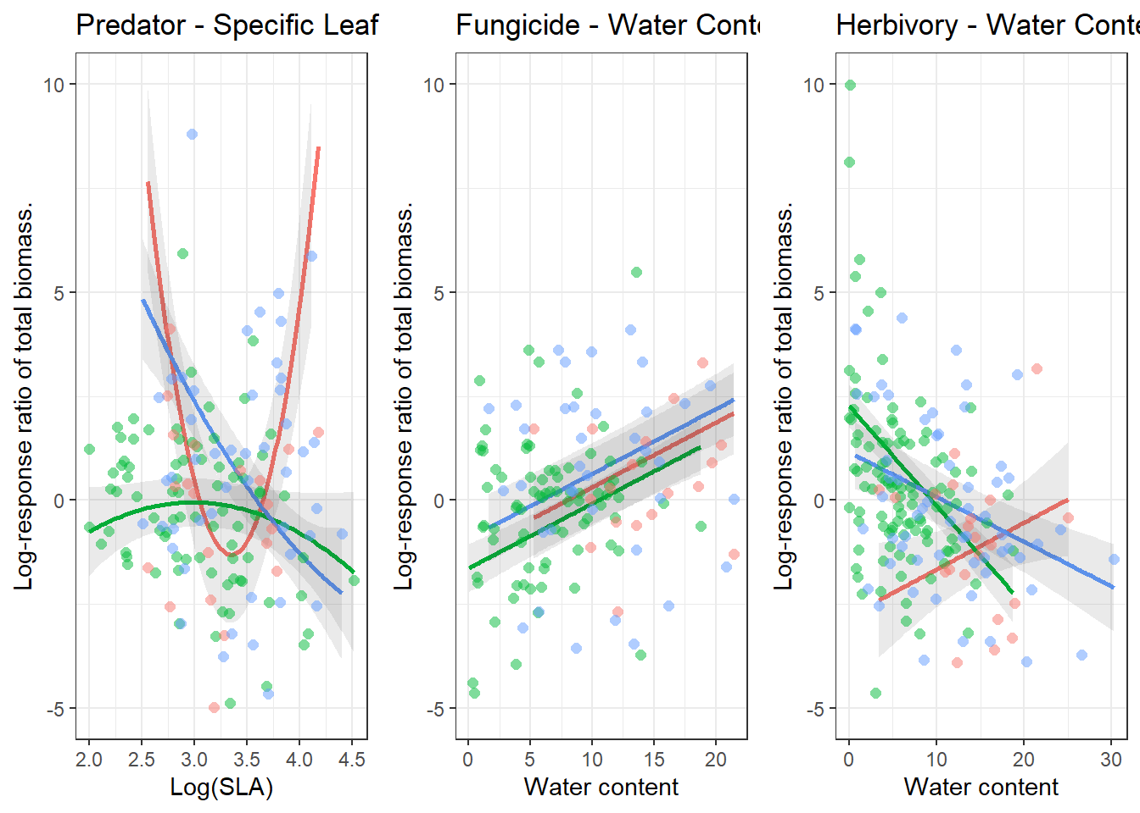
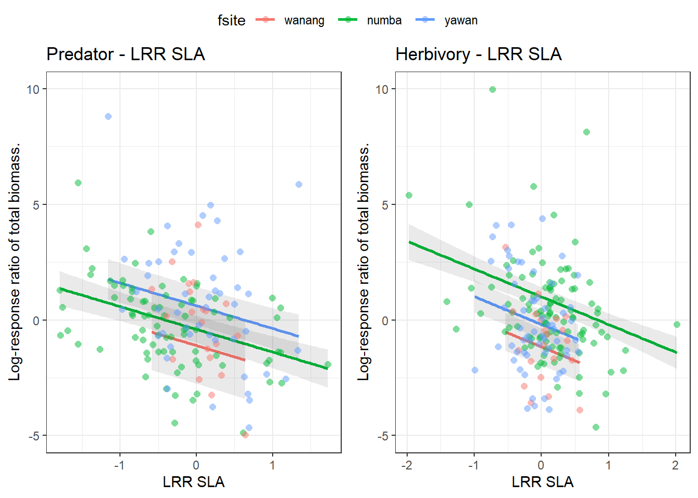
Traits and Responses
ΔBiomass ~ SLA × site + SLA^2 × site + water.content × site + water.content^2 × site + perc.herb × site + perc.herb^2 × site + richness + abundance + ΔSLA + (Phylogenetic structure).
Individual species responses: SLA varying response to predator presence across elevations, with different patterns.
High water content was promoted by insects at the low elevation (compensation?).
Fungi also promoted species with high water content.

Slide 13
Conclusions and Implications
The influence of biotic factors vary at different elevations.
No strong cascading effects.
Limited trait-mediated effects.
Involvement of intermediate predators and/or additional mechanisms.
Possible compensation of mortality factors.
A need to consider broader ecological contexts.

Slide 14



Thank you for your attention
Questions?
Collaborators:
Austin Sau
Martin Volf
Kenneth Molem
Vojtech Novotny
Piotr Szefer
szefer85@gmail.com

